Slide 1
Tools for data processing: R
Pieter Provoost
IOC-UNESCO

Slide 2

Tools: R
Open source environment for statistical computing and graphics
Created in 1993 at the University of Auckland, inspired by S
Rapidly gaining popularity for machine learning and business intelligence

Slide 3
Tools: R
Why R?
Automate
Data cleaning
Quality control
Analysis
Data publishing
Easily make changes to your workflow and rerun analysis
Reproducible research!
http://rpubs.com/benmarwick/csss-rr
https://rpubs.com/marschmi/105639

Slide 4

Tools: R

Slide 5
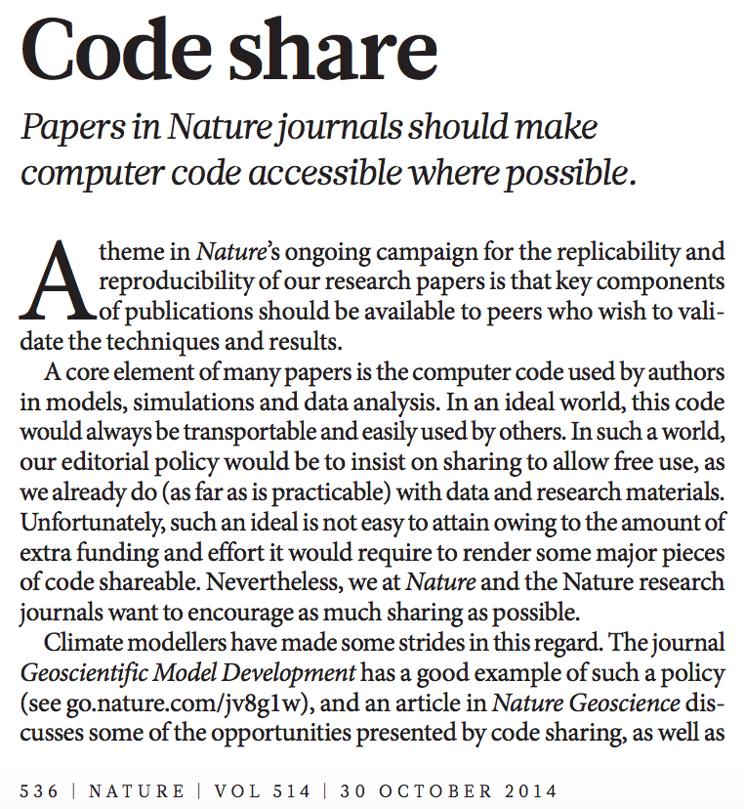
Tools: R

Slide 6
Tools: R
The R ecosystem
R Core Team, http://r-project.org
Packages
CRAN (The Comprehensive R Archive Network): 8600 packages
Bioconductor
rOpenSci
Omegahat
GitHub
R User Groups
Enterprise
Revolution Analytics (Microsoft R Server)
RStudio: RStudio IDE, Shiny (web applications)

Slide 7
Tools: R
Introduction to R
http://beta.iobis.org/manual/intror/
http://rforcats.net/ (Scott Chamberlain)
http://swirlstats.com/
Installation
Install R from https://cloud.r-project.org/
Install RStudio from https://www.rstudio.com/products/rstudio/download/

Slide 8
Tools: R
RStudio

Slide 9
Tools: R
Demo 1: introduction
https://github.com/iobis/training/tree/master/fixo3
OBIS R package
https://github.com/iobis/robis
Installation
ggplot
http://www.r-graph-gallery.com/all-graphs/
http://tutorials.iq.harvard.edu/R/Rgraphics/Rgraphics.html
https://github.com/jrnold/ggthemes
install.packages("devtools")
devtools::install_github("iobis/robis")

Slide 10
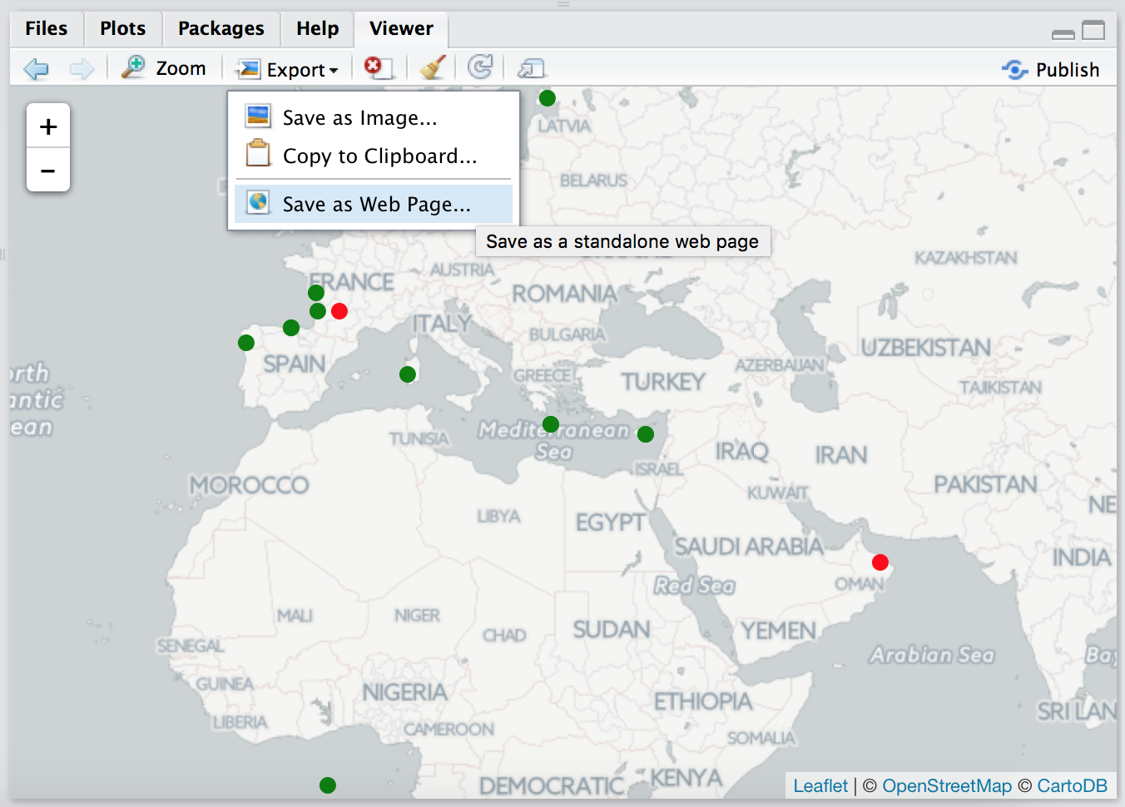
Tools: R
Demo 2: cleaning data
leaflet
https://rstudio.github.io/leaflet/
export map

Slide 11
Tools: R
Demo 3: rOpenSci packages
https://ropensci.org
packages
rfishbase: interface to fishbase.org
rgbif: interface to GBIF
mapr: species occurrence maps
spocc: species occurrence toolkit
rredlist: interface to IUCN Red List
taxize: search taxonomic data sources
finch: read DwC-A files

Slide 12
Tools: R
Demo 4: data analysis
reshape
http://www.statmethods.net/management/reshape.html
vegan
http://cc.oulu.fi/~jarioksa/opetus/metodi/vegantutor.pd

